Slide 1


Powered By .

Slide 2

What is a Socket Connection?
A socket is one endpoint of a two-way communication link between two programs running on the network bound to a port number .

Slide 3
What is a Socket Connection?
Server
Port
Port
Client
Connection Request
Listener

Slide 4

What is a Socket Connection?
Handshake
Server
Port
Port
Client
Connection Request
Listener

Slide 5


What is a Socket Connection?

Slide 6
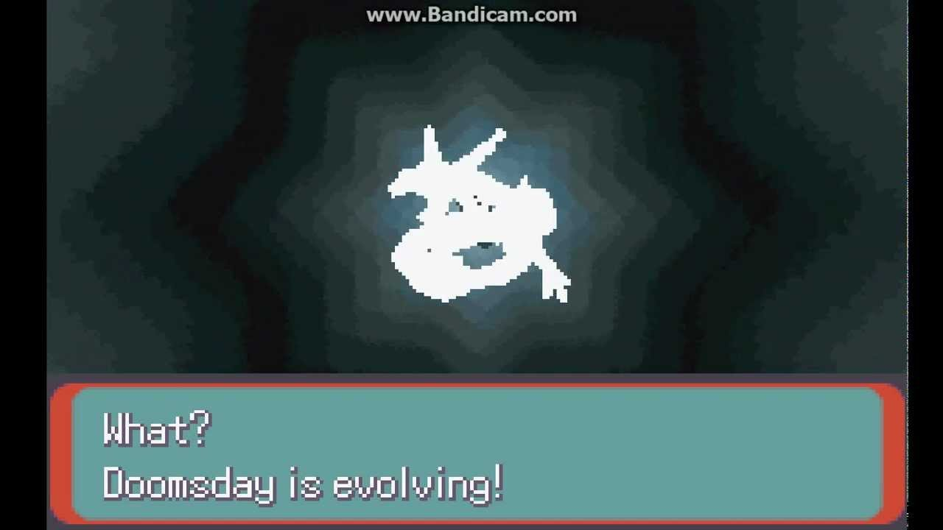

What is a Socket Connection?
HTTP

Slide 7
What is a Socket Connection?
Server
Port
Port
Client
Connection
Listener

Slide 8

Scaffolding

Slide 9
Create a basic connection with Express

Slide 10
Communicating with Sockets

Slide 11
Namespaces for Routing

Slide 12
Acknowledgements

Slide 13
Sending Volatile Messages

Slide 14

Honorable Mentions

Slide 15
GitHub
https://github.com/jvalverdekonrad/SocketsPowerHour

